Slide 1


IoT Simplicity
SWENG 837: Course Project
By: Jacob Black

Slide 2
Business Requirements
1. Problem Statement
Homeowners who buy IoT devices need a centralized system that can control these IoT devices, such as lighting, temperature, and security, in their home. This system should allow for multiple users to interact with it, be easy for users to interact with, be continuously available, and be able to utilize all functionality of the IoT devices.
2. Essential Functionality
Connect to new IoT devices
Connect to the Wi-Fi
Connect IoT devices to the Wi-Fi
Interact with IoT devices
3. Target Users
Anyone who buys or wants to use IoT devices
4. Business Goals
Ease of use: Users will want the system to be intuitive to set up and interact with
Reliability: Users will want the system to be reliably able to connect to the Wi-Fi and the IoT devices.

Slide 3
Non-Functional Requirements
Scalability | The system should allow up to 100 users to interact with the system and up to 100 IoT devices to be connected.
Response Time | The response time should be less than 500 milliseconds.
Throughput | The throughput should always be at least 80% of the Wi-Fi router’s capability.
Authentication | Each user should have a username and password with which they log into the system.
Authorization | There should be a primary owner that can control the level of controls others in the household have.
Data Encryption | All data should be encrypted and only information relevant to errors should be send outside the system.
Documentation | All troubleshooting strategies should be thoroughly documented.
Test Strategies | All methods should be tested several times, such as adding new users, adding new devices, and adding IoT devices to the Wi-Fi.
Availability | The app should be available 99% of the time

Slide 4
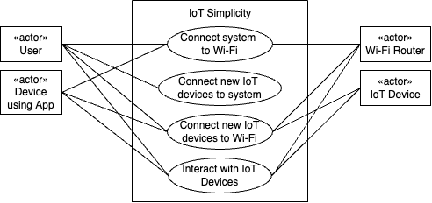
Use Case Diagram
Notes:
Now we have the Use Case Diagram. First, the user should be able to use the App to connect to the Wi-Fi Router. Next, the user should be able to connect new IoT devices to the App. Then, the user should be able to connect new IoT Devices to the Wi-Fi Router. Finally, the user should be able to use the app to control the IoT devices, which sends messages through the Wi-Fi Router to accomplish this.

Slide 5
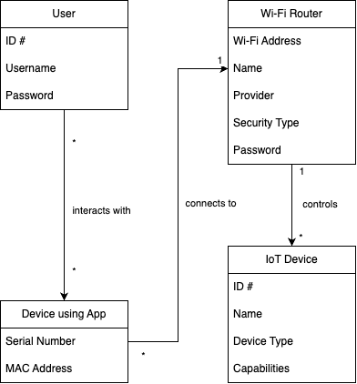
Domain Diagram

Slide 6
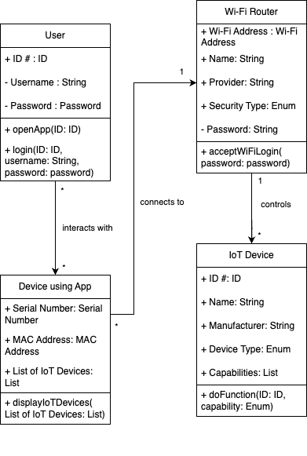
Class Diagram

Slide 7
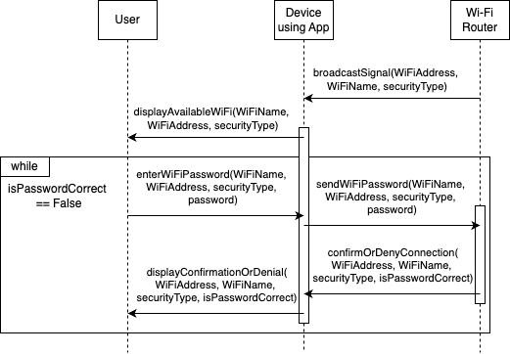
Sequence Diagram: connectSystemToWifi

Slide 8
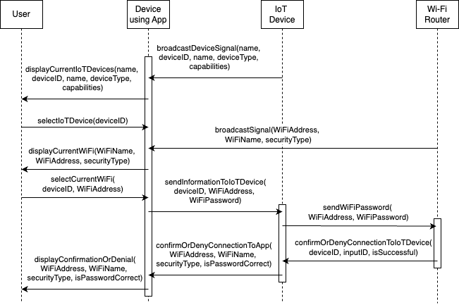
Sequence Diagram: connectIoTDeviceToWiFi

Slide 9
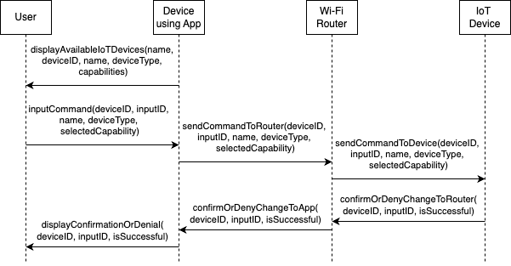
Sequence Diagram: interactWithIoTDevice

Slide 10
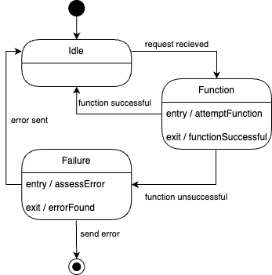
State Diagram: IoT Device

Slide 11
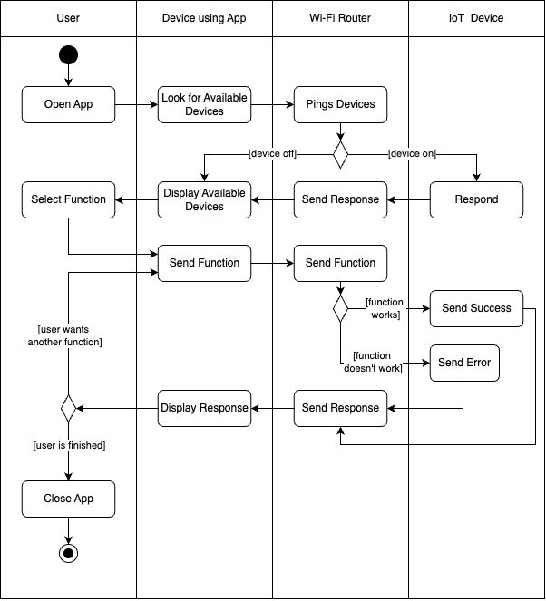
Activity (Swimlane) Diagram

Slide 12
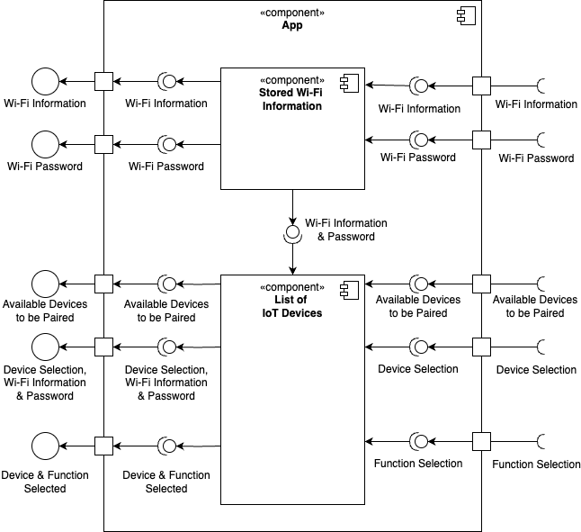
Component Diagram

Slide 13
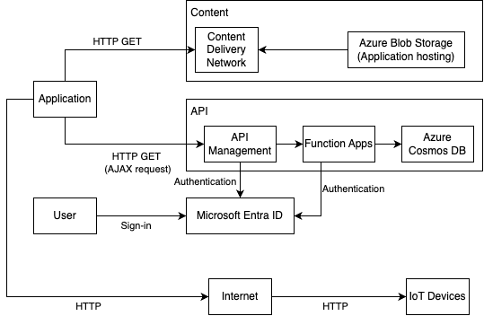
Cloud Deployment Diagram

Slide 14
Design Patterns
GRASP
Low Coupling: Every object has low coupling, since there is low dependency, and everything can easily be reused. The IoT devices can be modified by multiple users because of this.
Controller: The app on the device controls all functions of the IoT devices.
SOLID
Open Closed Principle: The IoT Device class is an open class, as it’s available for extension.
GOF
Mediator: The Wi-Fi router acts as a mediator between the device with the app and the IoT Device. This allows for the IoT devices to not be tied to a single device and be modifiable by multiple users.
Microservices
API Gateway: An API Gateway is used to manage the different possible functionalities of the IoT devices.

Slide 15
Thank you!
IoT Simplicity
Notes:
I appreciate you taking the time to listen to my software project about IoT Simplicity. I hope this will make your life simpler! Thank you!

